Slide 1

CBA Trading Challenge
Georgia Wang

Slide 2
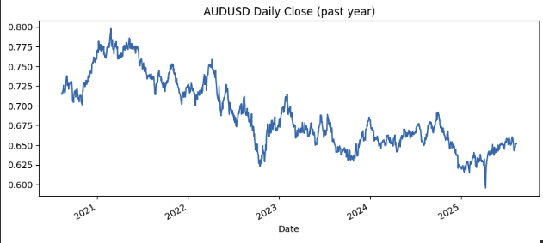
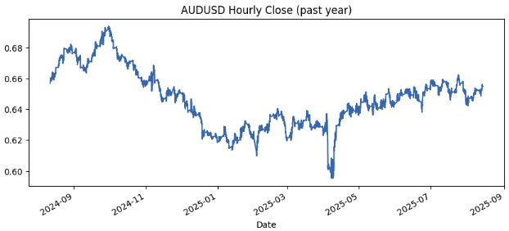
Data - FX
Source: Yahoo finance
24- hour prediction: 12th Aug 2024 – 12th Aug 2025 (8760 data points)
30-day prediction: 12th Aug 2020 – 12th Aug 2025 (1825 data points)
Data cleaning
Standardising column names
Checking for NaN values
Removing unnecessary rows
Check dimensions

Slide 3
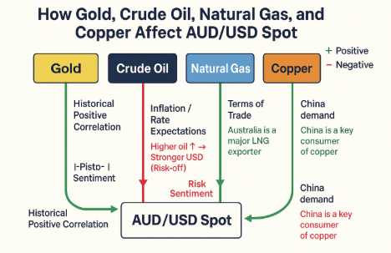
Data – Commodity Futures
Source: Yahoo Finance
Gold
Copper
Crude Oil – “Oil”
Natural Gas

Slide 4

Background Research
Existing machine learning approaches for Fx trading
Logistic regression : binary classifier (direction)
Support Vector Machine (SVM) : binary classifier
K-Nearest Neighbours (KNN) : needs scaling + can be noisy
Decision Trees : easily overfit
Artificial Neural Networks (ANNs) : data hungry
Statistical models
ARIMA/SARIMA
After differencing → all noise → flat line (reverts to mean reversion)
Source: https://e-forex.net/machine-learning-in-fx-trading-beyond-the-hype-and-some-useful-algos/#:~:text=Support%20Vector%20Machines%20was%20the,second%20place%20with%20competitive%20results.

Slide 5
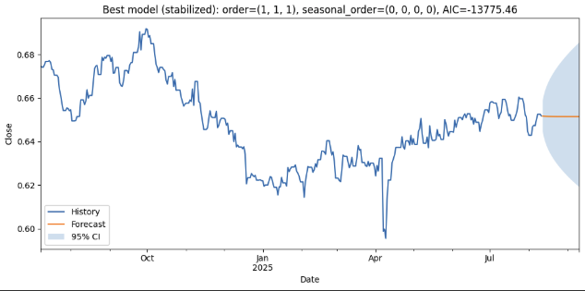
Basic ARIMA / SARIMA
Notes:
I tested ARIMA on the historical daily prices. After differencing to remove the trend — which ARIMA requires for stationarity — the resulting series was essentially white noise, meaning it had no strong autocorrelation or seasonal structure.
Because there was no predictable pattern left, the model defaulted to a mean-reversion forecast — essentially a flat line with a confidence band — which isn’t useful for our application, you can see the flat forecast – orange line
That’s why I decided not to use ARIMA/SARIMA and instead explored other approaches that can incorporate external drivers or non-linear effects. (ask chat gpt for a skeleton code for ARIMA → didn’t spend much time just was curious)
Focus on machine learning which I have had more experience with
Autoregressive: past affects future
Integrated (difference data to remove trend and make static) → not what we want
Moving average ( past forecast errors can help predict future values)

Slide 6
Model – 24-hour prediction
Random Forest regression + Walk forward validation
70/30 split (training/test data)
Timeseriesplit (no shuffling)
Target: AUDUSD Close
Random Forest Regression
Nonlinear + interactions
Good with noise
Walk forward approach
simulate live data ,
rolling window 2000h,
refit every 48h, warm up ~500h
Notes:
Why Random Forest:
AUDUSD moves depend on momentum, trend, vol, and commodities in a non-linear way. Random Forest captures those relationships without me hand-specifying them.
Fast and stable for walkforward, an train in parallel so I can refit in a rolling window to make the system not static
Automatic feature importance calculation
RF is robust to noisy, granular data because it averages many trees (bagging) → lower variance, less overfitting than a single tree.
Reduces variance is the correct wording
Why Walk Forward:
- predict, reveal, and slide and each hour t
Only trains on data up to t-1 (also prevents future data to leak into past data)
Freeze model and predict the value at t
Slides training window forward and repeats (refit every N hours, adjustable)
Supposed to simulate if new data was rolling in how the system would react and adjust

Slide 7
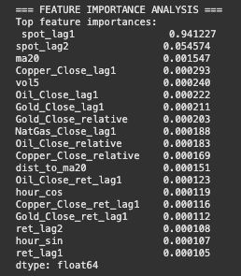

Feature engineering
All features were initially included
Only most important features were selected to be in the final model
Spot_lag1
Spot-Lag2
Ma20 (moving average)
Vol5 (past vol)
Notes:
- spot_lag1 – last hour’s spot; captures the strong autocorrelation in FX and gives a baseline for the next move.
- spot_lag2 – spot two hours ago; with lag1, it helps the model tell momentum vs. mean-reversion over very short horizons.
- ma20 – 20-hour moving average (computed from past only); encodes the slow trend/anchor the price tends to revert toward.
vol5 – 5-hour realised volatility (past only); measures recent noise/risk, helping the model scale expected changes in quiet vs. volatile regimes.
I assume that commodities will have greater affect on the 30 day prediction
Choose to remove because, since it is not important it can actually make the model accuracy worse because its just another thing that would cloud its judgement
To optimise these features → parameter tuning (grid search/ gradient)

Slide 8

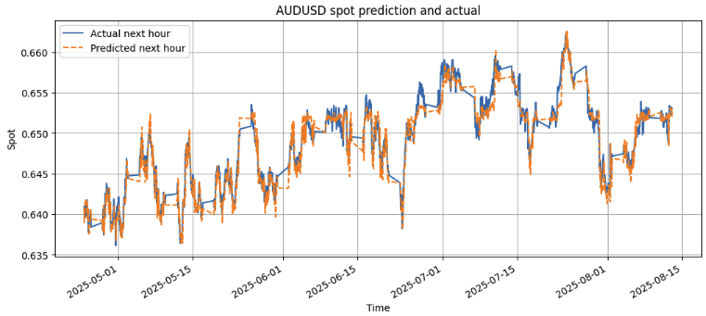
Some initial visualisations …
Notes:
More underfitting than overfitting
I think its because its due to the nature of RF where it is robust to noise, underfitting is seen after there has been a more abrupt change in spot
This diagram is only from 24th April – 12th aug (30%, test data)

Slide 9
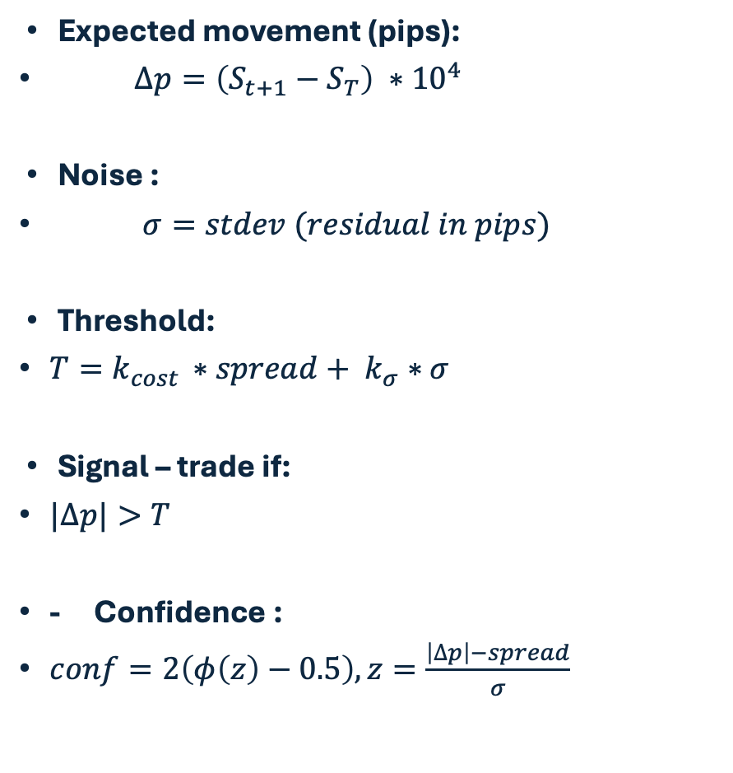
Signal Generation/Confidence/Movement
Expected movement (pips):
$∆p=\left(S_{t+1}−S_{T}\right) ∗{10}^{4}$
Noise :
$σ=stdev (residual in pips)$
Threshold:
$T=k_{cost }∗spread+ k_{σ}∗σ$
Signal – trade if:
$|∆p|>T$
- Confidence :
$conf=2\left(φ\left(z\right)−0.5\right), z=\frac{\left|∆p\right|−spread}{σ}$
Notes:
Expected movement : how many pips I expect the price to move next interval/bar
Noise (sigma) = how wrong the model typically is , residual = actual – predicted
Threshold: the minimum move I need before I am willing to trade
Signal: only trade if change is > T
Confidence: how likely the forecasted move beats costs given recent error
(Phi(z) = standard normal CDF)
Z score – how many sigmas above costs the forecast is
Sigma = std-dev of recent prediction residuals in pips

Slide 10
Prediction of overhead 24 hours – method 1
Separate walk-forward RF one per selected horizon with walk forward loop
Train one RF per horizon h = 1,…,4,…,8,…12,…16,…20,…24
Same feature engineering
Interpolate between chosen hours (linear interpolation)
Dependent on trained model
Trade off:
High computing power, very slow to run (approx. 10-15mins)
Linear interpolation is not good for hourly data, hourly Fx spots have much more variance → cubic splines

Slide 11
Momentum + Mean reversion
Mean reversion (what goes up must come down)
df["aud_vs_ma20"] = (df[target_col] / df["aud_ma20"] - 1).shift(1) # deviation from trend
E.g.
If aud_vs_ma20 = +0.02: Price is 2% above its 20-day average → expect price to fall
If aud_vs_ma20 = -0.015: Price is 1.5% below average → expect price to rise
Momentum (follow the trend)
df["ma_momentum"] = (df["aud_ma20"] / df["aud_ma50"] - 1).shift(1) # trend strength
E.g.
If aud_ret5 = +0.02: Price up 2% over last 5 days → expect continued upward momentum

Slide 12
Prediction of overhead 24 hours – method 2
24 separate Random forests (RF), one per horizon
Train one RF per horizon h = 1,…,24
Same feature engineering
Refit the 24 small models each time a new hour arrives
No need for Interpolation
Trade off:
Model independent from walk forward model (initial model)
No walk forward validation per horizon (risk of optimistic performance)

Slide 13
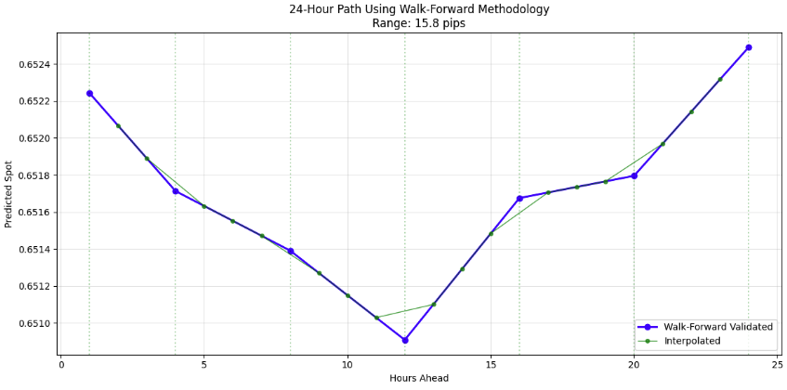
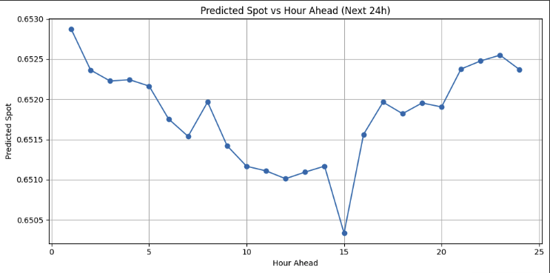
Prediction Results
Method 1
Method 2
Notes:
Can see they both follow a downward trend and eventually turns into an upward trend

Slide 14
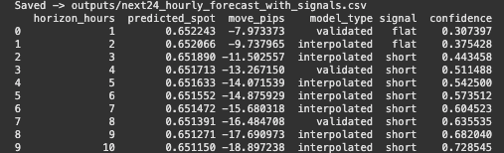
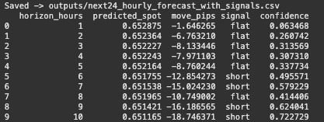
Outputs from both methods (snippet)
Method 1
Method 2
Notes:
Good things:
They agree on the spot direction, both methods point to a downward path over the next 10 hours
Method 1 begins issuing short signals earlier with rising confidence
Method 2 more conservative early then turns short from 6 hours onwards
Probably will get a lot better results with a different interpolation method or somehow optimise the code so that running for each hour will not take as long.
Either short or flat (doesn’t go above threshold for a long signal) → predict that FX will go down
If we were actually trading and ran both, would be sensible to trade when both methods agree.
Approach to signal is very conservative + avoids overtrading
Requires move to be large compared to volatility

Slide 15
Model – 30-day prediction
Ridge regression + Walk forward validation
70/30 split (training/test data)
Features at standardised at every refit (StandardScaler)
Target: next day AUDUSD Close
Ridge Regression
Works well with smaller data points
Handles multicollinearity (much better than standard linear regression)
Fx shows more linear behaviour when data is less granular
Walk forward approach
simulate live data ,
rolling window500 trading days,
refit every30days , warm up ~200 days
Notes:
Why Ridge
- Limited samples: Daily data gives far fewer observations than hourly. Ridge (L2) stabilizes estimates when data is small.
- Collinearity friendly: Lags, moving averages, and commodity series are highly correlated. Ridge shrinks coefficients to handle multicollinearity.
- Lower variance: L2 regularization reduces variance (at the cost of a little bias), which helps generalize out-of-sample.
- Interpretable: Signs/magnitudes of coefficients tell a clear economic story (momentum, trend, commodity links).
- Fast & robust: Trains quickly, easy to refit on a rolling window; no heavy hyperparameter search required.
- Feature scaling: Standardized inputs each refit → coefficients are comparable; avoids features with larger scales dominating.
Why Walk Forward:
- predict, reveal, and slide and each hour t
Only trains on data up to t-1 (also prevents future data to leak into past data)
Freeze model and predict the value at t
Slides training window forward and repeats (refit every N hours, adjustable)
Supposed to simulate if new data was rolling in how the system would react and adjust

Slide 16
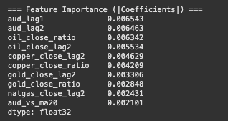
Feature engineering
All features were included
Here, commodities rank much higher than it did for our 24-hour model
1. crude oil
2. copper
3. Gold
4. Natural Gas
Notes:
- spot_lag1 – last hour’s spot; captures the strong autocorrelation in FX and gives a baseline for the next move.
- spot_lag2 – spot two hours ago; with lag1, it helps the model tell momentum vs. mean-reversion over very short horizons.
- ma20 – 20-hour moving average (computed from past only); encodes the slow trend/anchor the price tends to revert toward.
vol5 – 5-hour realised volatility (past only); measures recent noise/risk, helping the model scale expected changes in quiet vs. volatile regimes.
Here commodities need to be lagged by 2 days because we used data from commodity futures, → just to make sure they match the spot timeframe

Slide 17

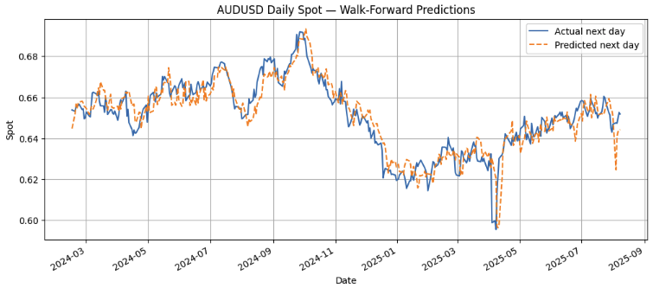
Some initial visualisations …
Notes:
Here, we see a ”worse fit” than our 24 hour prediction model
Less data points (not ass accurate )
However, there is a lot less ”smoothening” effects than RF when an abrupt change in spot (if RF , green arrow would be smooth, detected as noise)
Due to not averaging logic of multiple decisions
Actually better for daily FX
Massive dip in April → trump tariffs (if I could have more time I would a case where a large drop (defined by some number) should be alerting macroeconomic effects (green arrow)
Somehow the model already has predicted this massive drop quite well → probably due to features in the model , this one probably triggered more by the momentum feature (detected strong trend) - also because we are predicting based on lags
“The lag features give the model yesterday’s reality—low level, big negative return, high vol, far below trend—so on the next bar it sensibly predicts a weak price. It’s not predicting the event; it’s using memory of the shock to forecast its immediate aftermath, with no look-ahead.”
add event dummies, rate differentials (AU–US short end), China/commodity macro proxies, news/sentiment scores, and test longer lags for futures (e.g., 2–5 days) so the model can anticipate rather than merely react.
E.g. today is aug10, using aug9 data to predict aug 11 and keeps rolling forward like that (walkforward logic)

Slide 18
Signal Generation/Confidence/Movement
Expected movement (pips):
$∆p=\left(S_{t+1}−S_{T}\right) ∗{10}^{4}$
Noise :
$σ=stdev (residual in pips)$
Threshold:
$T=k_{cost }∗spread+ k_{σ}∗σ$
Signal – trade if:
$|∆p|>T$
- Confidence :
$conf=2\left(φ\left(z\right)−0.5\right), z=\frac{\left|∆p\right|−spread}{σ}$
Notes:
Expected movement : how many pips I expect the price to move next interval/bar
Noise (sigma) = how wrong the model typically is , residual = actual – predicted
Threshold: the minimum move I need before I am willing to trade
Signal: only trade if change is > T
Confidence: how likely the forecasted move beats costs given recent error
(Phi(z) = standard normal CDF)
Z score – how many sigmas above costs the forecast is
Sigma = std-dev of recent prediction residuals in pips
Same as 24 hour prediction, numbers change (made an educated guess but need more backing to which numbers to use for these parameters)

Slide 19
Prediction of overhead 30 days – method 1
Separate walk-forward ridge regression one per selected horizon with walk forward loop
Train one model per horizon h = 1,…,30
Same feature engineering
Interpolate between chosen hours (linear interpolation)
Dependent on trained model
Trade off:
- Linear interpolation is still not ideal for daily data, daily Fx spots have much more variance → cubic splines
Notes:
- Here the code runs a lot faster and can be run for every single day in those 30 days, (A LOT LESS data points than hourly, almost 8x less)

Slide 20

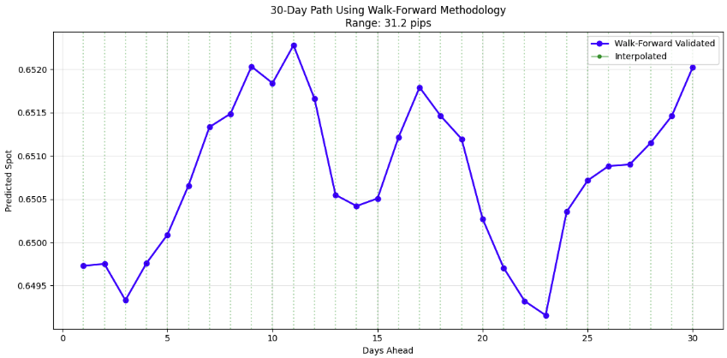
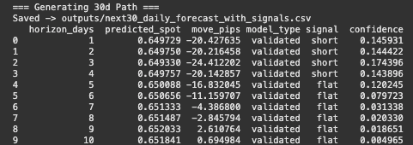
Prediction results
Notes:
If we were predicting with same amount of data points as hourly probably need to interpolate between points (choose which horizons to validate)
Begins short signal and turns flat
Either short or flat (doesn’t go above threshold for a long signal) → predict that FX will go down

Slide 21
Limitations/Future Improvements
No hyperparameter tuning
No optimisation of all parameters
Grid search method
Data coverage (limited for daily)
Good if we had PnL data
Could measure risk better (VAR)
Need to improve/add to trading signals
No link to macro-events,
Create macro informing features which inform the model of expected events (mostly public, know in advance)
Commodity influence on hourly data is stale
Daily model would benefit from seeing >1 day legs

Slide 22
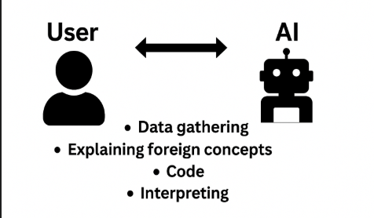
AI-first strategy!

